Slide 1
CDJMM Software Solutions.
CSC 131 - Computer Software Engineering
Software Development Project
Fall 2011
for
Sacramento State Aquatic Center
CJ Thakor
Darby Hannon
Joubin Jabbari
Madelyn Bachiller
Mike Poku
December 15, 2011

Slide 2
Project Requirements
PROBLEM(WHAT?):
Current Paper-based Rental System of the Sacramento State
Aquatic Center needs to be turned into a Computerized System
1. Sign In
2. Adult/Minor
3. Waiver
4. Equipment Rental
5. Sync to Class Database
6. Inventory
7. Previous Page / Start Over
8. Check in Complete
9. Return and Time Stop
10. Admin Log In
11. Profile Deletion
12. Generate Report

Slide 3

Overview of Design -- DFD Level 0
SOLUTION(HOW?): Aquatic Center Tracking System (ACTS)

Slide 4
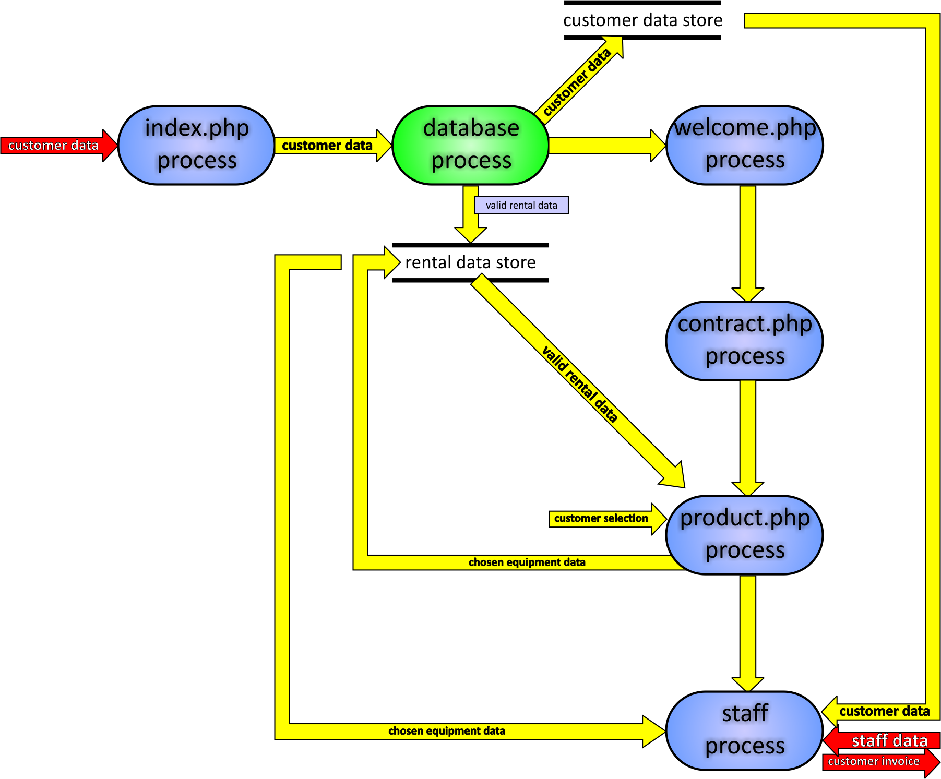
Overview of Design -- DFD Level 1

Slide 5
Tools/Resources
Apache 2.2.17
MySQL Client Version 5.1.54
PHP Version 5

Slide 6
Lessons Learned
Team Work
Regular Meetings
Team Communication
Documentation
Software Requirement Specification (SRS)
Software Design Document (SDD)
Diagrams
Software Development Process
Requirements
Design
Implementation
Testing

Slide 7
Demo of the Aquatic Center Tracking System (ACTS)
Overview of ACTS
Customer Flow using ACTS
Admin/Staff Flow using ACTS
Other Key Features

